Slide 1
Neural Networks

Slide 2
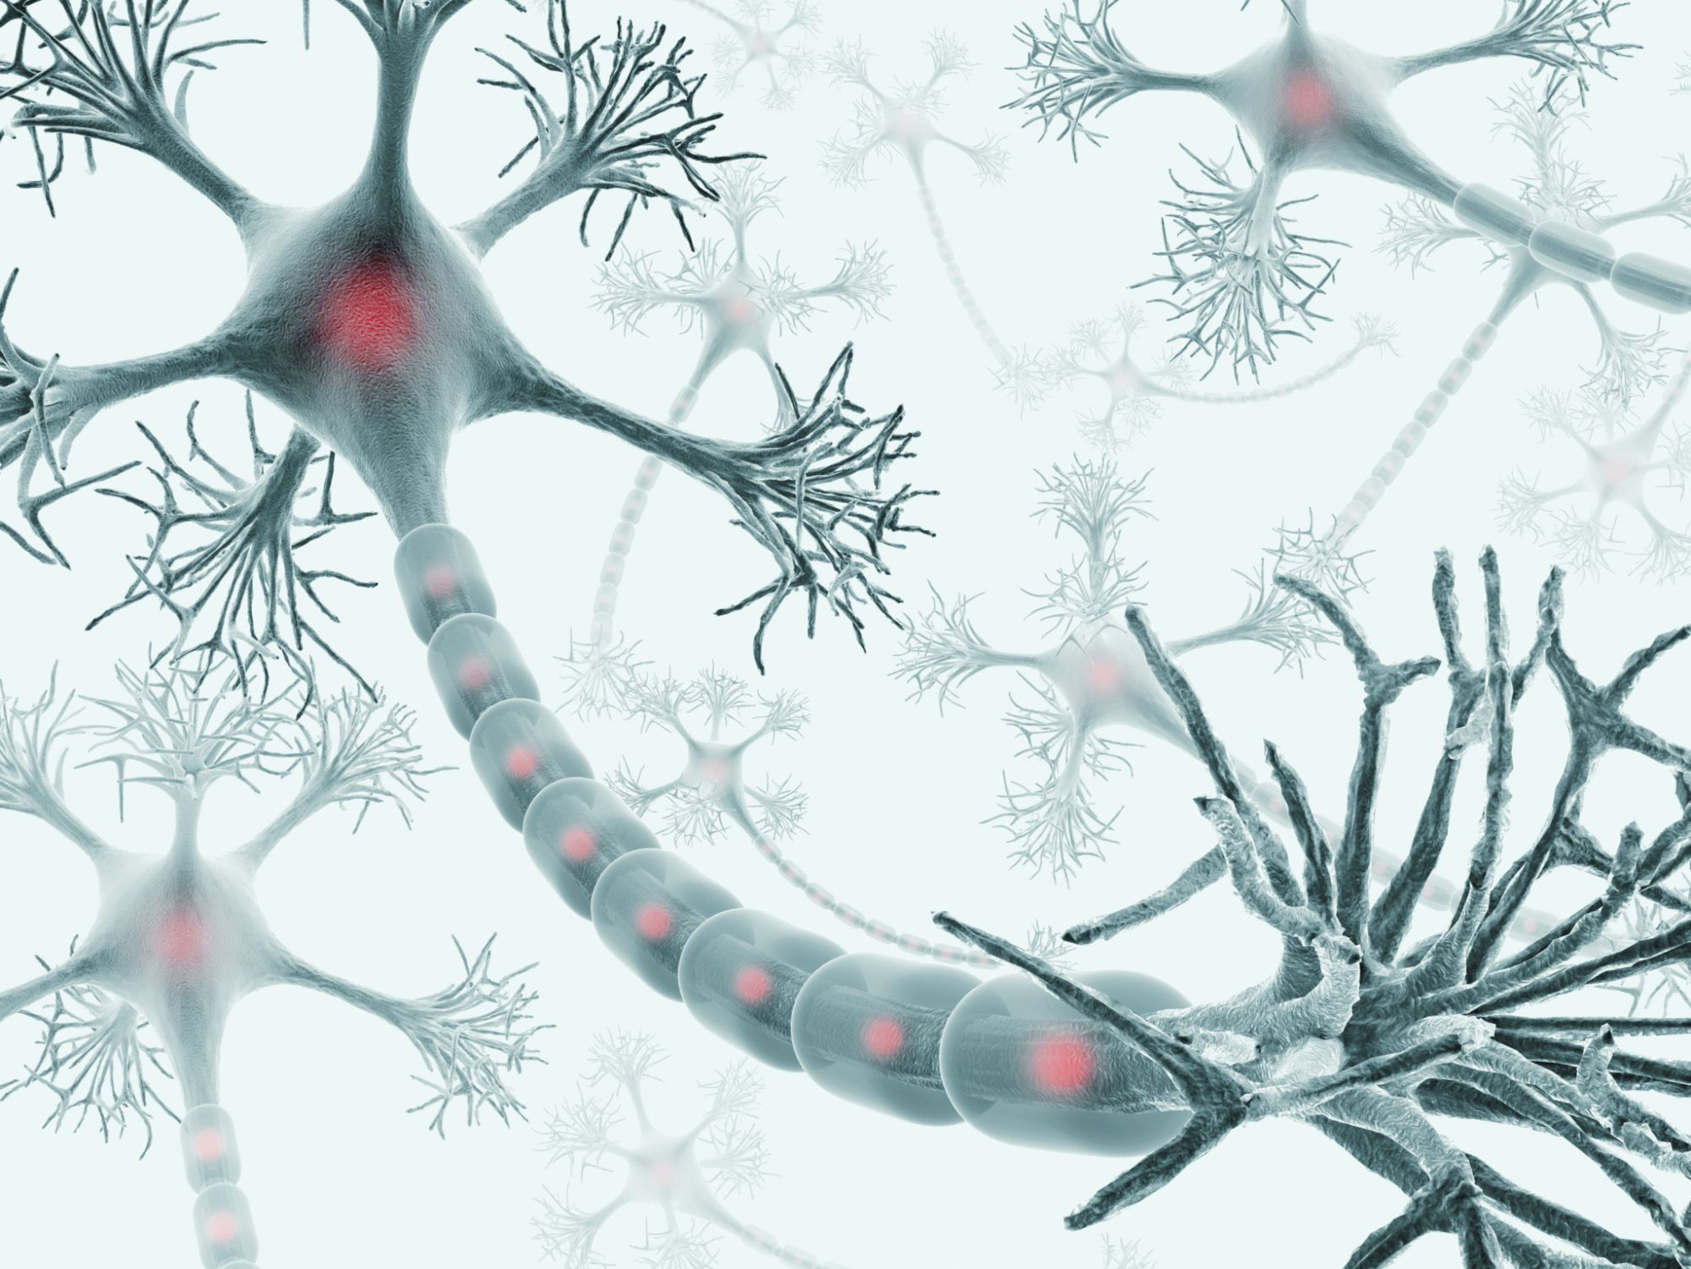
Powerful highly parameterized models that are inspired by the human brain
Very flexible and allow the learning of any continuous function!

Slide 3
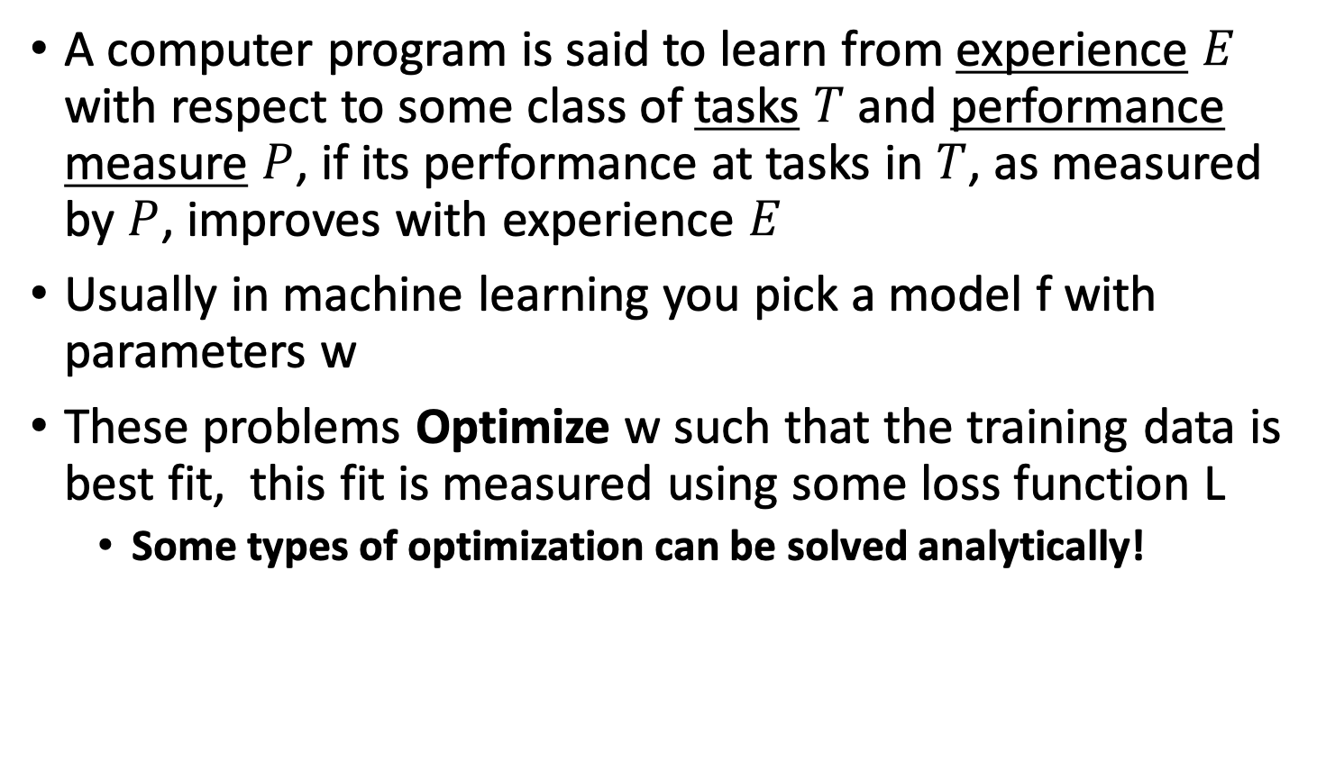
What is Learning?
A computer program is said to learn from experience $E$ with respect to some class of tasks $T$ and performance measure $P$, if its performance at tasks in $T$, as measured by $P$, improves with experience $E$
Usually in machine learning you pick a model f with parameters w
These problems Optimize w such that the training data is best fit, this fit is measured using some loss function L
Some types of optimization can be solved analytically!

Slide 4
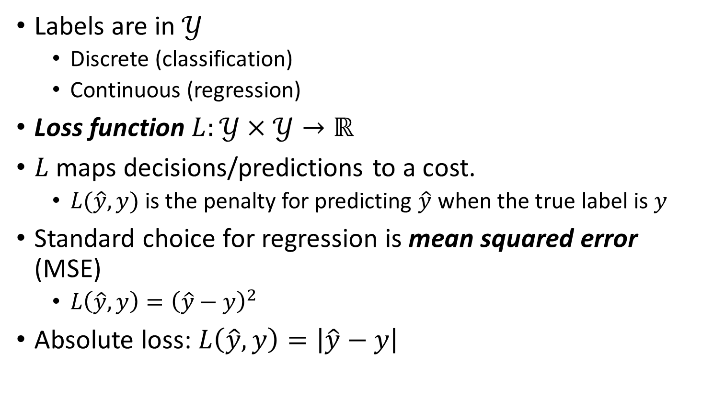
Loss functions
Labels are in $𝒴$
Discrete (classification)
Continuous (regression)
Loss function $L:𝒴×𝒴→ℝ$
$L$ maps decisions/predictions to a cost.
$L(\hat{y},y)$ is the penalty for predicting $\hat{y}$ when the true label is $y$
Standard choice for regression is mean squared error (MSE)
$L\left(\hat{y},y\right)={\left(\hat{y}−y\right)}^{2}$
Absolute loss: $L\left(\hat{y},y\right)=\left|\hat{y}−y\right|$

Slide 5
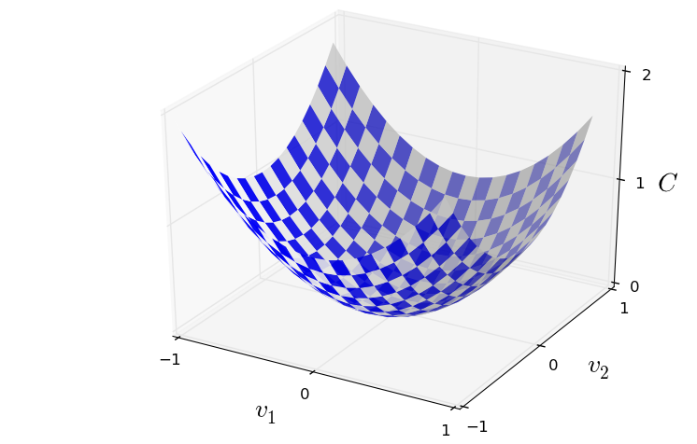
Loss Minimization
Minimum
Convex loss functions can be solved by differentiation, at the point where Loss is minimum
the derivative should be 0!

Slide 6
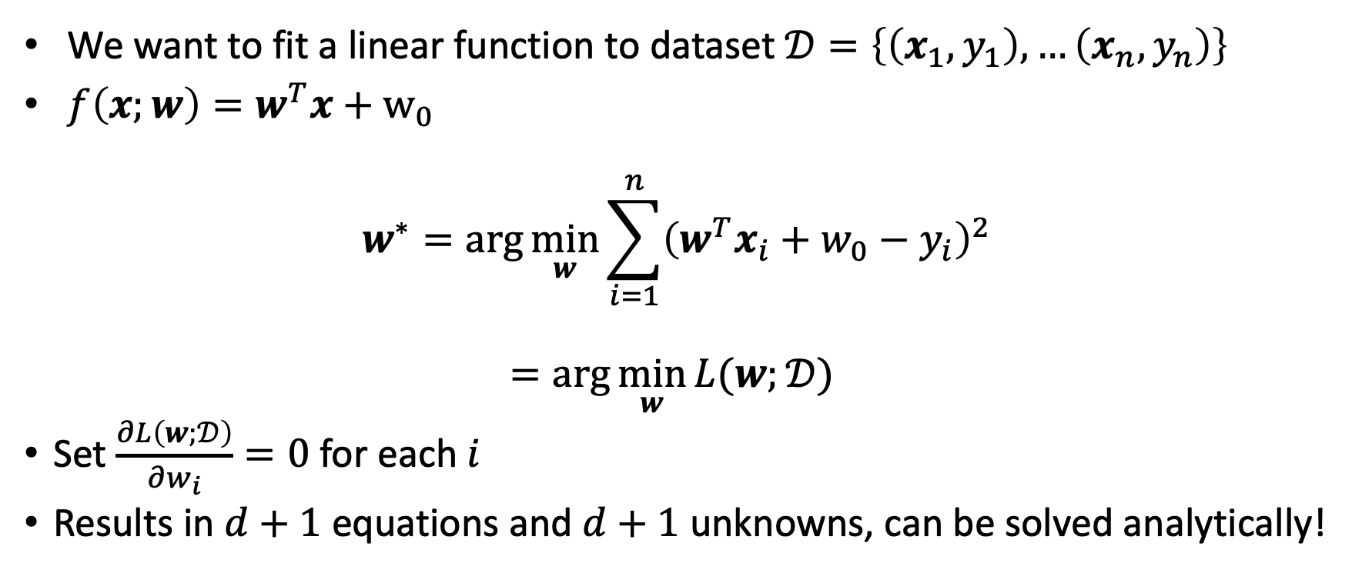
Linear Regression Optimization
We want to fit a linear function to dataset $𝒟=\left\{\left(x_{1},y_{1}\right),…\left(x_{n},y_{n}\right)\right\}$
$f\left(x;w\right)=w^{T}x+w_{0}$
$$w^{∗}=\arg{\min_{w}{\sum_{i=1}^{n}{{\left(w^{T}x_{i}+w_{0}−y_{i}\right)}^{2}}}}$$
$$=\arg{\min_{w}{L(w;}𝒟) }$$
Set $\frac{∂L\left(w;𝒟\right)}{∂w_{i}}=0$ for each $i$
Results in $d+1$ equations and $d+1$ unknowns, can be solved analytically!

Slide 7
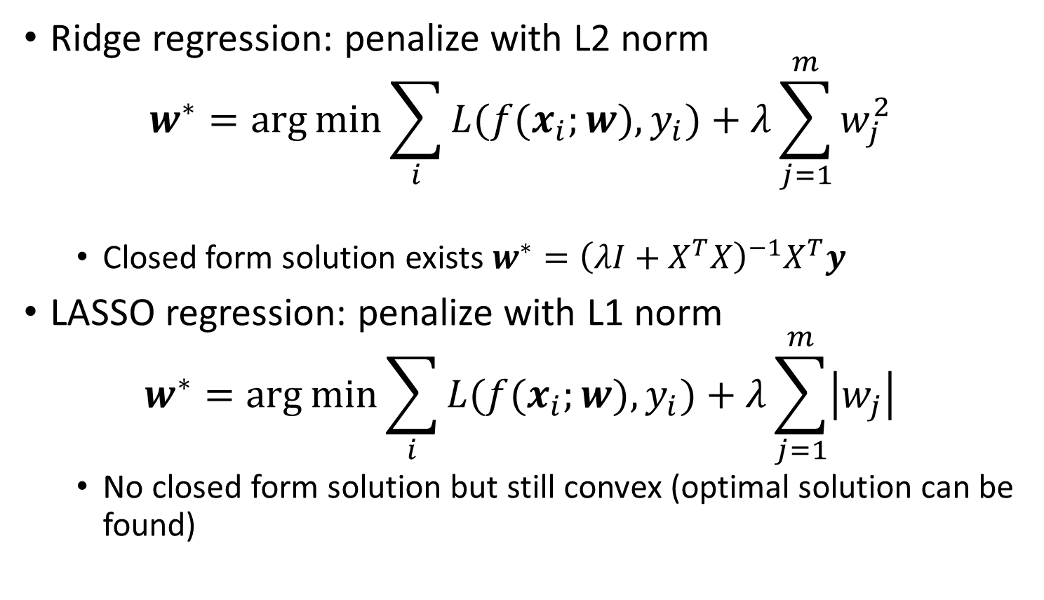
Regularization
Ridge regression: penalize with L2 norm
$$w^{∗}=\arg{\min{\sum_{i}{L(f(x_{i};w),y_{i})}+λ\sum_{j=1}^{m}{w_{j}^{2}}}}$$
Closed form solution exists $w^{∗}={\left(λI+X^{T}X\right)}^{−1}X^{T}y$
LASSO regression: penalize with L1 norm
$$w^{∗}=\arg{\min{\sum_{i}{L(f(x_{i};w),y_{i})}+λ\sum_{j=1}^{m}{\left|w_{j}\right|}}}$$
No closed form solution but still convex (optimal solution can be found)

Slide 8
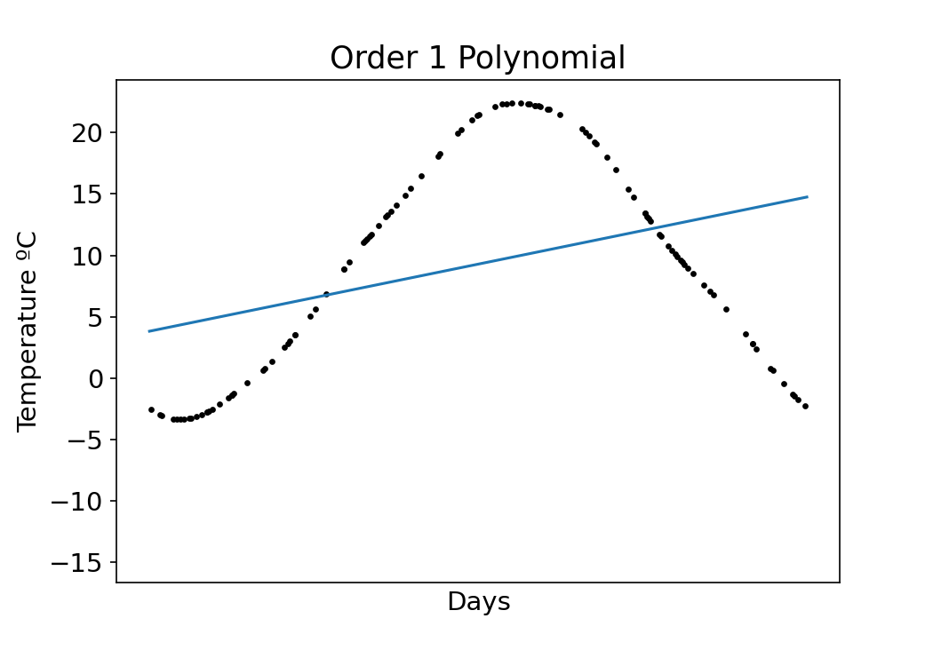
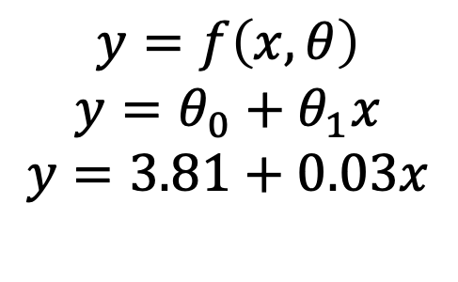
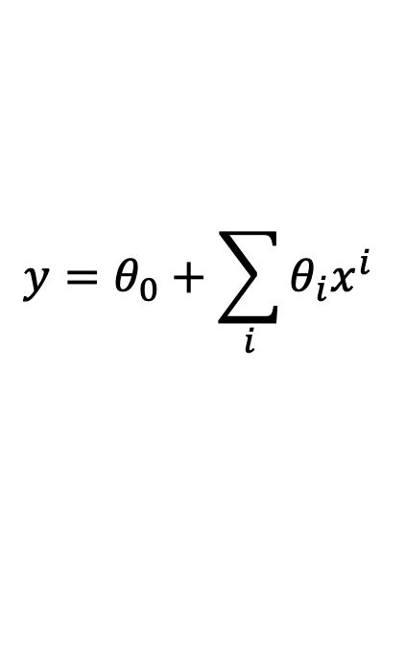
Predictions on new data
$$y=f\left(x,θ\right)$$
$$y=θ_{0}+θ_{1}x$$
$$y=3.81+0.03x$$
$$y=θ_{0}+\sum_{i}{θ_{i}x^{i}}$$

Slide 9
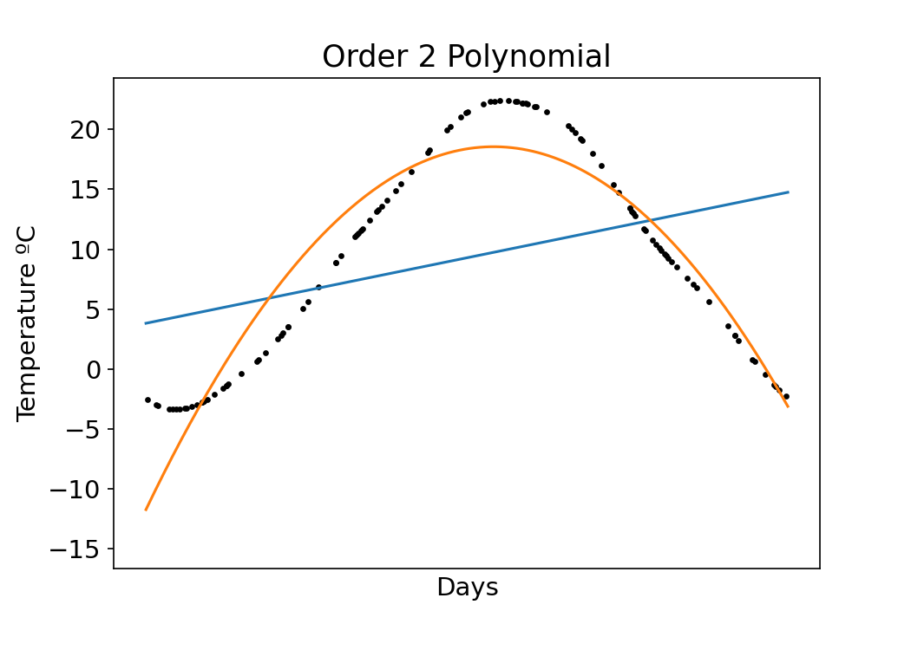
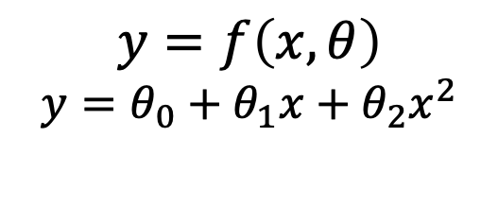
$$y=f\left(x,θ\right)$$
$$y=θ_{0}+θ_{1}x+θ_{2}x^{2}$$

Slide 10
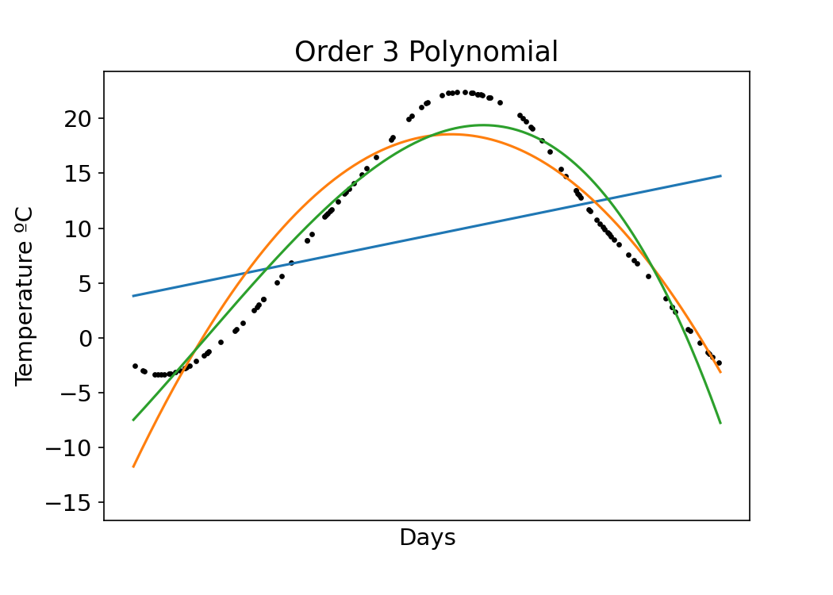
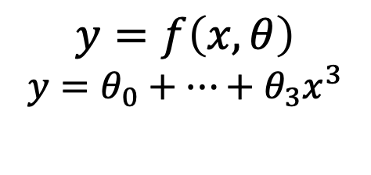
… even more parameters
$$y=f\left(x,θ\right)$$
$$y=θ_{0}+…+θ_{3}x^{3}$$

Slide 11
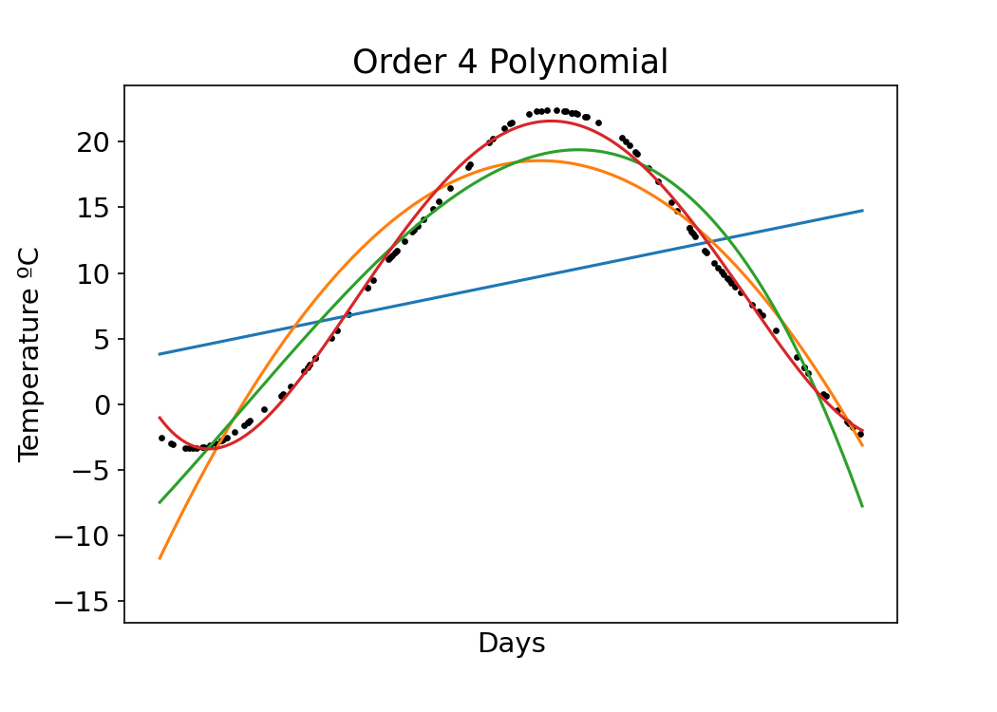
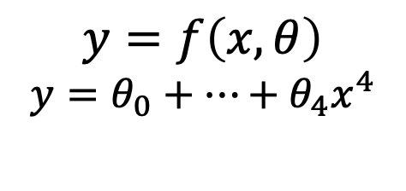
…even more parameters
$$y=f\left(x,θ\right)$$
$$y=θ_{0}+…+θ_{4}x^{4}$$

Slide 12
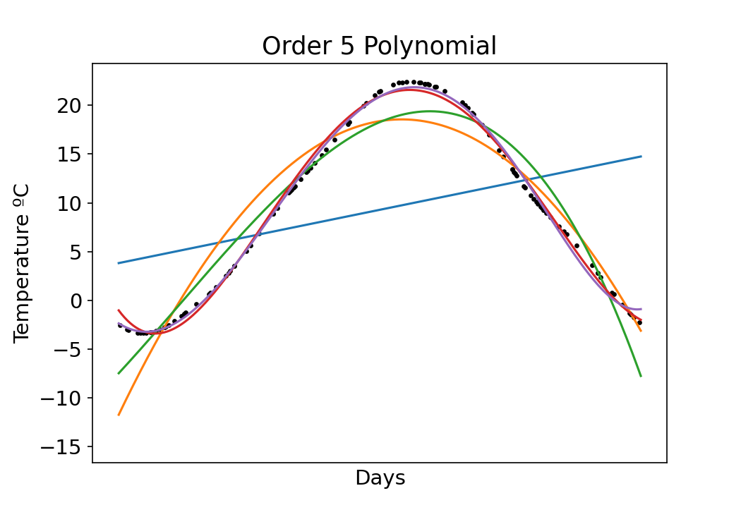
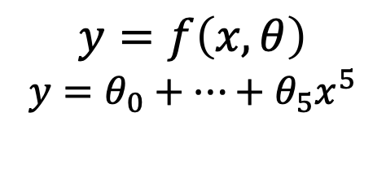
…even more parameters
$$y=f\left(x,θ\right)$$
$$y=θ_{0}+…+θ_{5}x^{5}$$
Increasing parameters improves model fit!

Slide 13
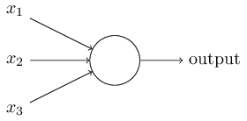
The perceptron
Developed in 1950’s and 1960’s by Frank Rosenblatt
Binary inputs
Single binary output
Example:
Nielsen, 2015
Notes:
In general could have more or fewer inputs.
Mention that figures come from Michael Nielsen’s book

Slide 14
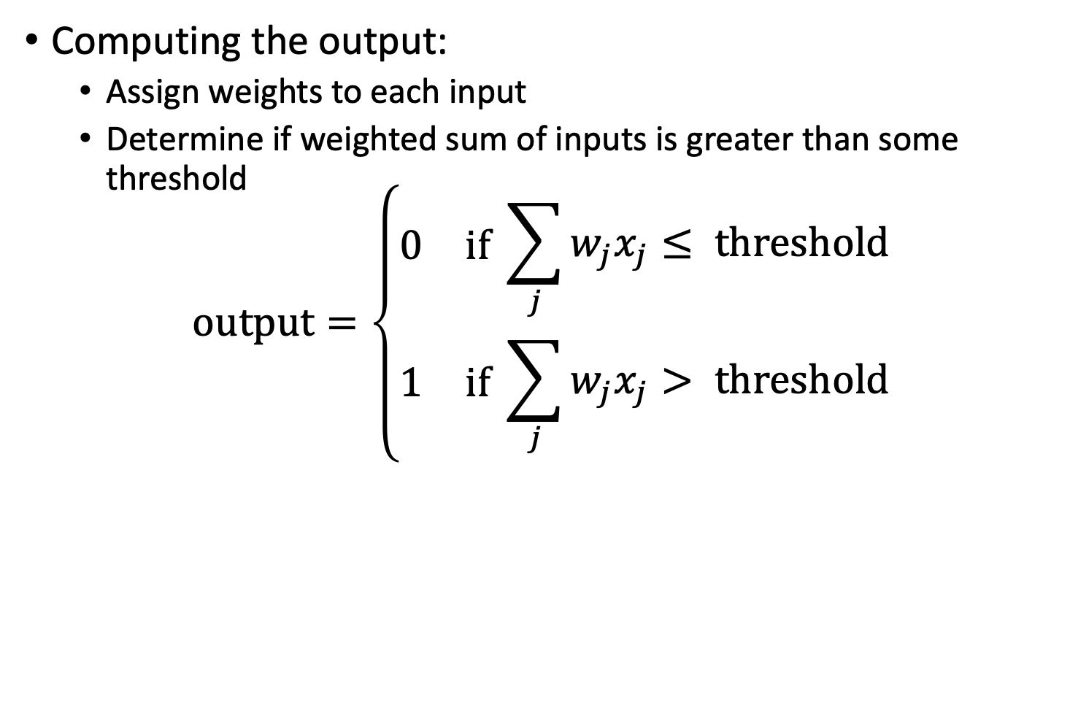
The perceptron
Computing the output:
Assign weights to each input
Determine if weighted sum of inputs is greater than some threshold
$$\text{output}=\left\{\begin{aligned}\begin{matrix}0 & \text{if} \end{matrix}\sum_{j}{w_{j}x_{j}}≤ \text{threshold} \\ \begin{matrix}1 & \text{if} \end{matrix}\sum_{j}{w_{j}x_{j}> \text{threshold}}\end{aligned}\right.$$
Nielsen, 2015

Slide 15
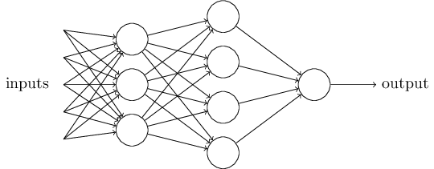
The multilayer perceptron (MLP)
A single perceptron is pretty simple
A complex network of perceptrons can make subtle decisions
First Layer
Second Layer
Nielsen, 2015
Notes:
In this network, the first column of perceptrons - what we'll call the first layer of perceptrons - is making three very simple decisions, by weighing the input evidence. What about the perceptrons in the second layer? Each of those perceptrons is making a decision by weighing up the results from the first layer of decision-making. In this way a perceptron in the second layer can make a decision at a more complex and more abstract level than perceptrons in the first layer. And even more complex decisions can be made by the perceptron in the third layer. In this way, a many-layer network of perceptrons can engage in sophisticated decision making.
Emphasize that it is the same output going to each node

Slide 16
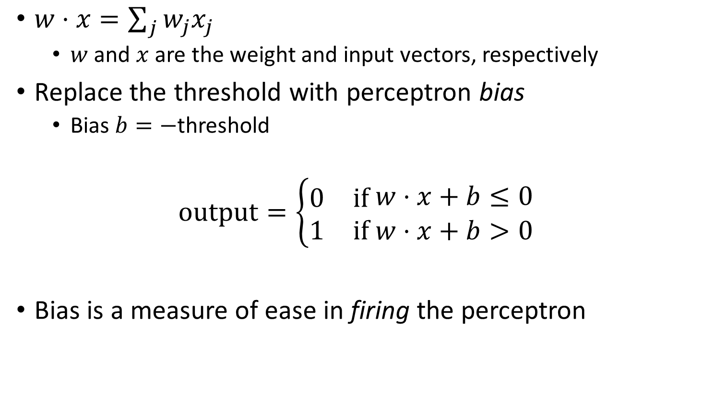
Bias
$w⋅x=\sum_{j}{w_{j}x_{j}}$
$w$ and $x$ are the weight and input vectors, respectively
Replace the threshold with perceptron bias
Bias $b=−$threshold
$$\text{output}=\left\{\begin{aligned}\begin{matrix}0 & \text{if} \end{matrix}w⋅x+b≤0 \\ \begin{matrix}1 & \text{if} w⋅x+b>0\end{matrix}\end{aligned}\right.$$
Bias is a measure of ease in firing the perceptron

Slide 17
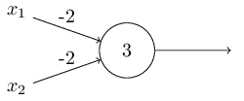
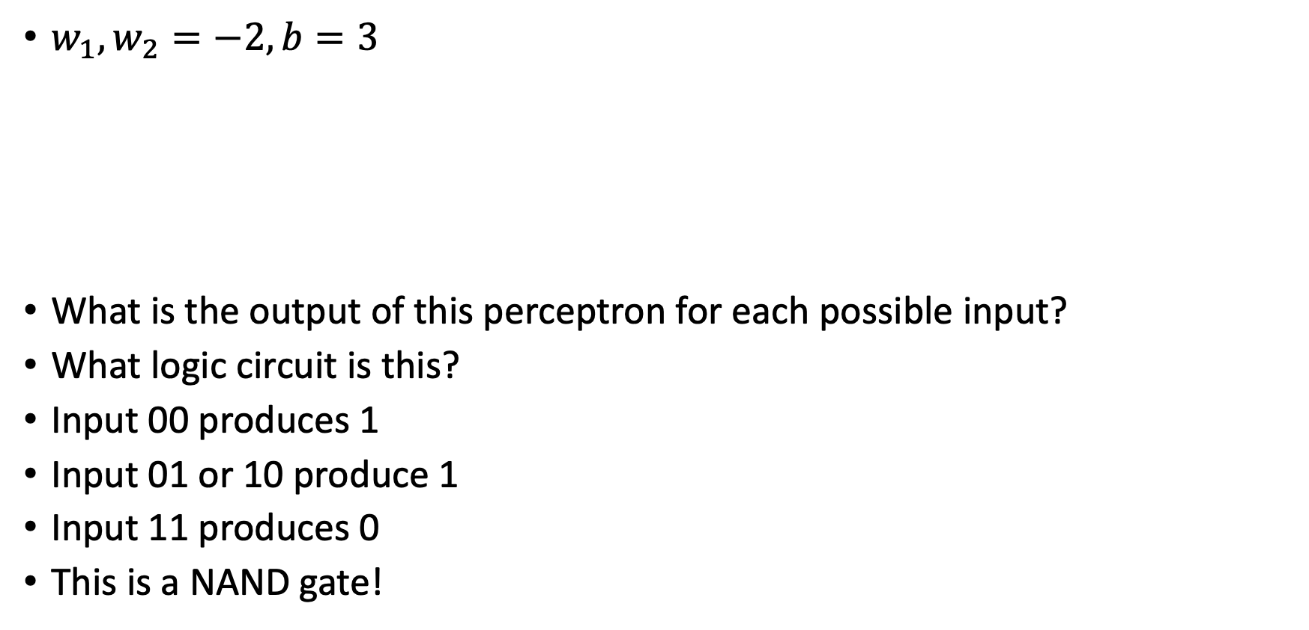
Logic circuits with perceptrons
$w_{1},w_{2}=−2, b=3$
What is the output of this perceptron for each possible input?
What logic circuit is this?
Input 00 produces 1
Input 01 or 10 produce 1
Input 11 produces 0
This is a NAND gate!
Nielsen, 2015
Notes:
Write this on the board maybe

Slide 18
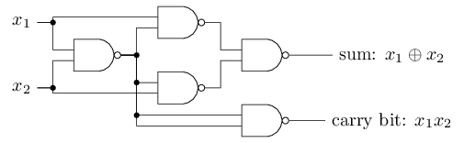
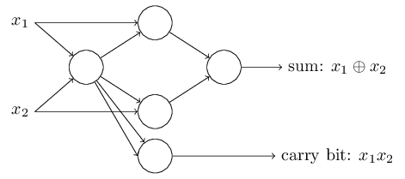
Logic circuits with perceptrons
NAND gates are universal for computation
Any computation can be built from NAND gates
Therefore, perceptrons are universal for computation
Bitwise addition:
Nielsen, 2015

Slide 19
Exercise
Create a 3-bit parity function with NAND gates

Slide 20
Problem with Logical Functions
Hard to “tune” in a traditional sense
Small change in weight can lead to large changes in conditions (or on change at all)
Think the volume knob in your car behaving this way
For this to happen we need neurons to perform a continuous differentiable function

Slide 21
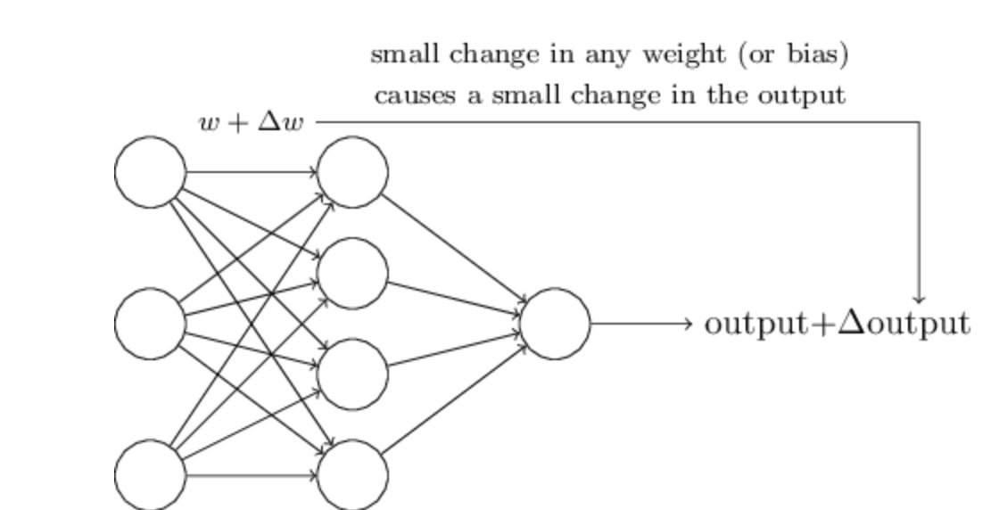
Differentiable Functions

Slide 22

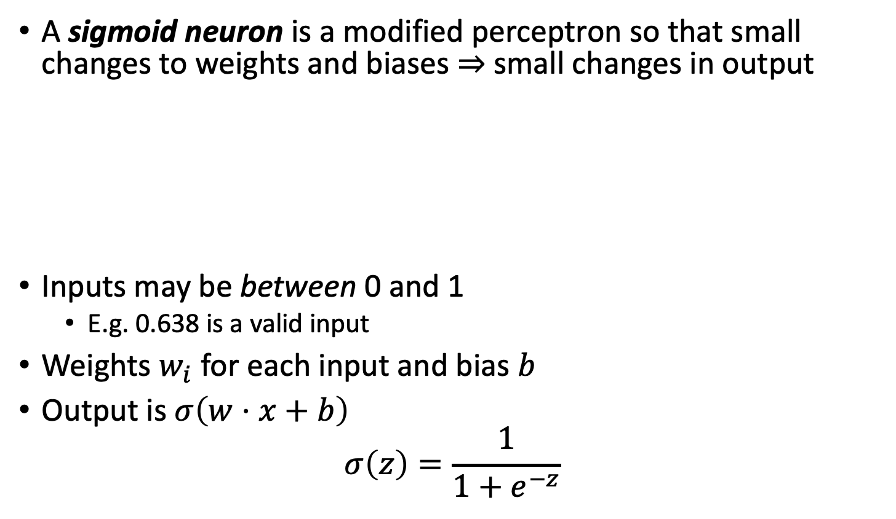
Sigmoid Neuron
A sigmoid neuron is a modified perceptron so that small changes to weights and biases $⇒$ small changes in output
Inputs may be between 0 and 1
E.g. 0.638 is a valid input
Weights $w_{i}$ for each input and bias $b$
Output is $σ\left(w⋅x+b\right)$
$$σ\left(z\right)=\frac{1}{1+e^{−z}}$$

Slide 23
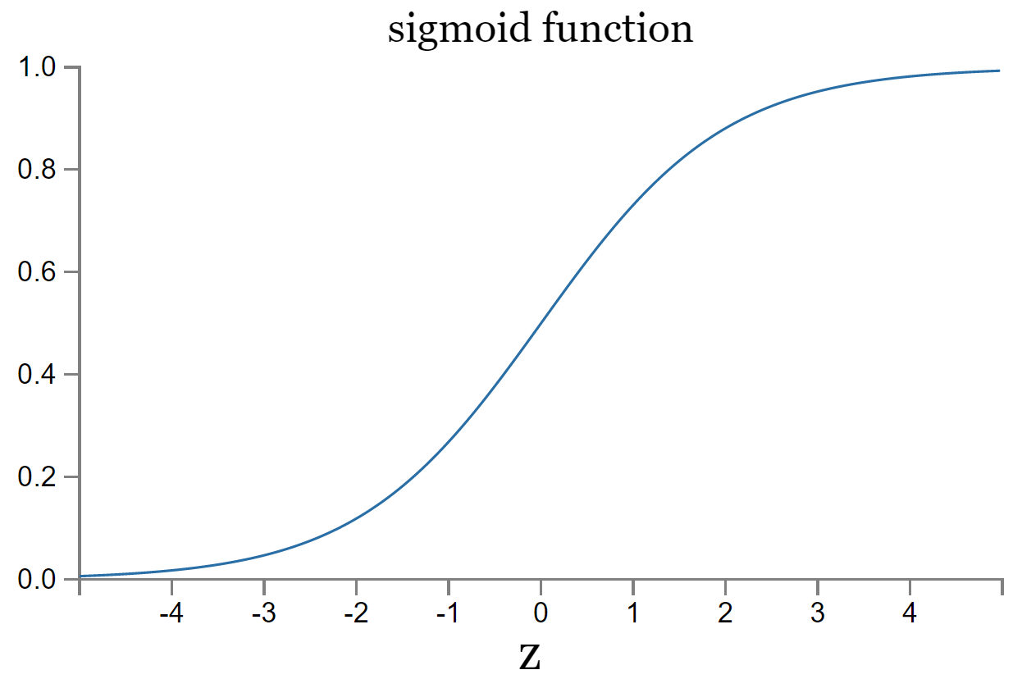
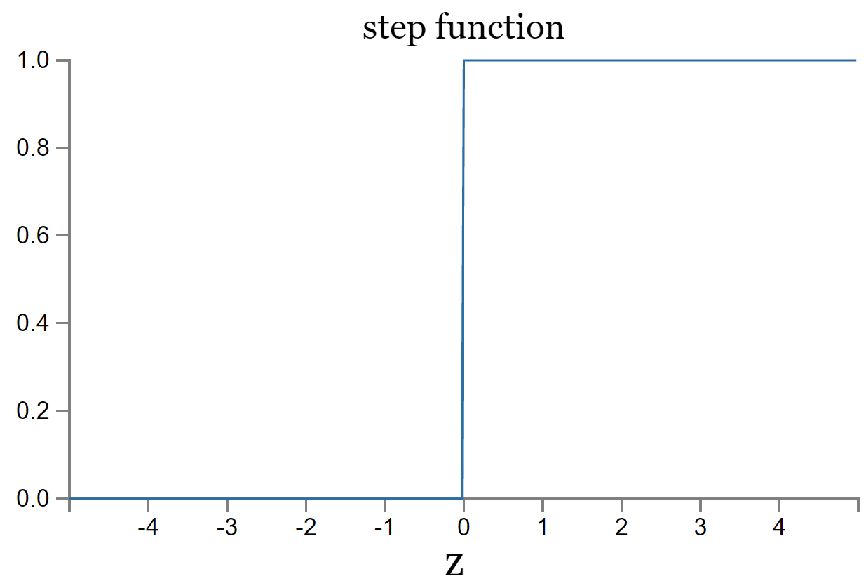

Relationship between sigmoid neuron and perceptrons
For the perceptron, $σ=$ the step function
Smoothness of the sigmoid function $⇒$ small changes in weights and biases produce small change in output
Notes:
The exact form of \sigma isn’t important. Instead, what matters is the shape. The sigmoid function is a smoothed version of the step function.

Slide 24

Exercise
What is the derivative of the sigmoidal function
If you changed the input of a sigmoidal function by $∆$, then how much would the output change?

Slide 25
Learning with Gradient Descent
We can create learning algorithms that automatically tune the weights and biases with Gradient Descent
Tuning occurs in response to external stimuli and w/o direct intervention
Creates a circuit designed for the problem at hand
First you take the derivative of the output weight with respect to the loss function
Then you propagate that backward all the way to the input using a procedure called backpropagation

Slide 26
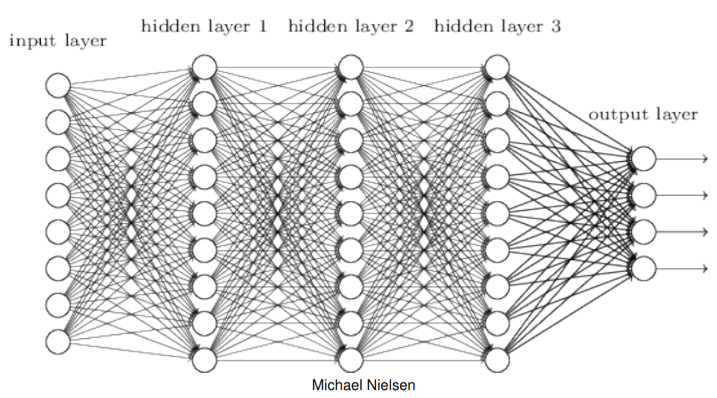
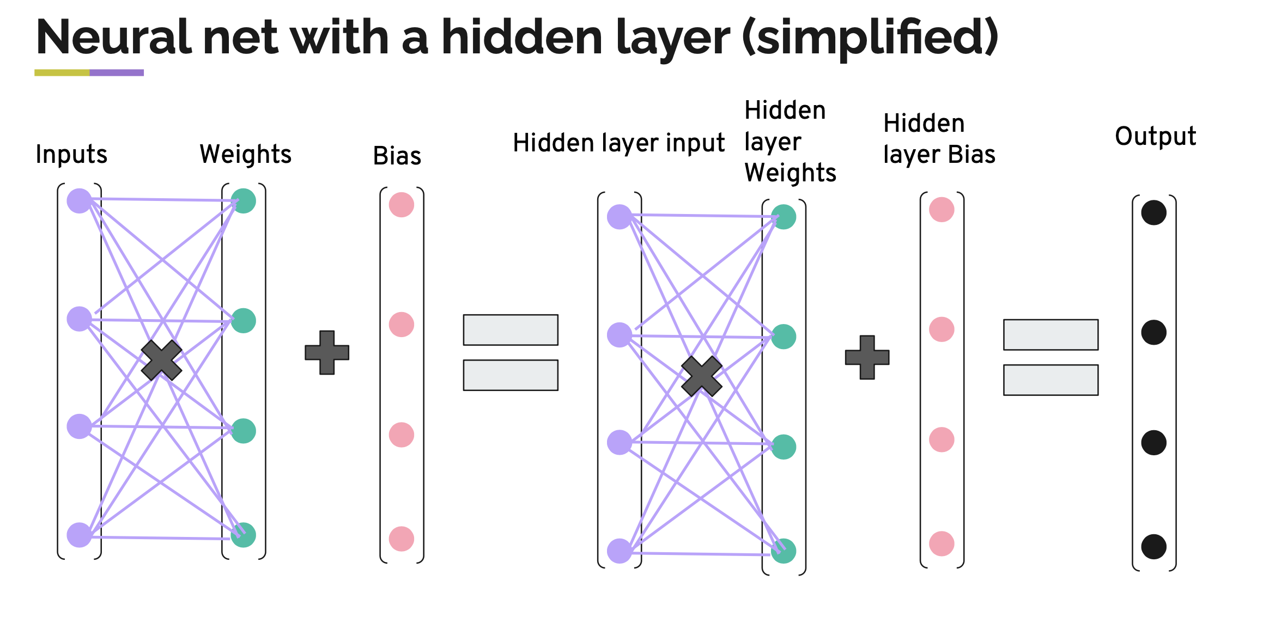
Fully connected network
Every feature interacts with every other feature
Weight matrix at every level allowed to be dense

Slide 27
Design choices for an ANN
Activation function (e.g. threshold)
Cost functions
Number and dimension of layers
Connections between layers
Regularizations
Layers
Batches
More…
Notes:
You can imagine that we can solve a rich set of problems by various design choices. Emphasize that we can have nonlinear functions and also continuous inputs and outputs instead of binary. We will cover all of these in detail throughout the course and is a large focus of the beginning

Slide 28
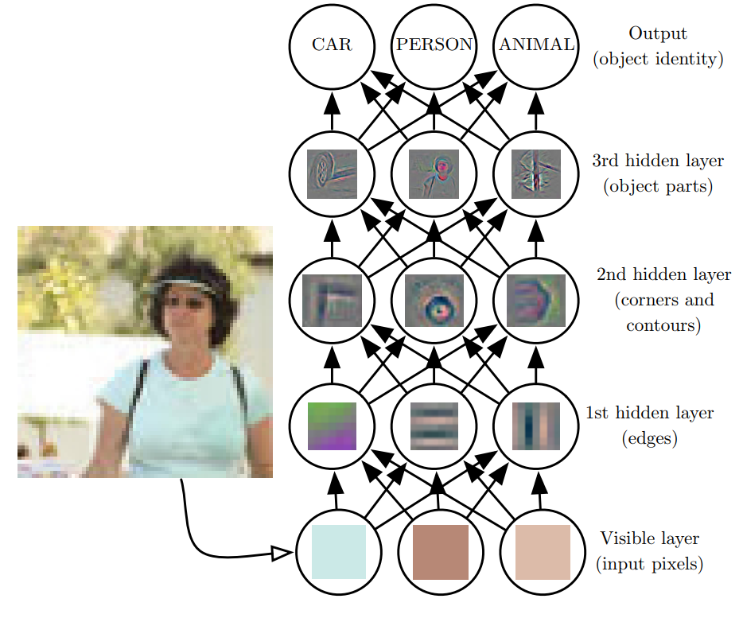
Network depth creates a composition of functions
Goodfellow et al., 2016
Notes:
Deep learning has the tendency to break the data down into different representations at different layers. Input is presented at the visible layer and the hidden layers extract increasingly abstract features which are then used, for example, to classify

Slide 29
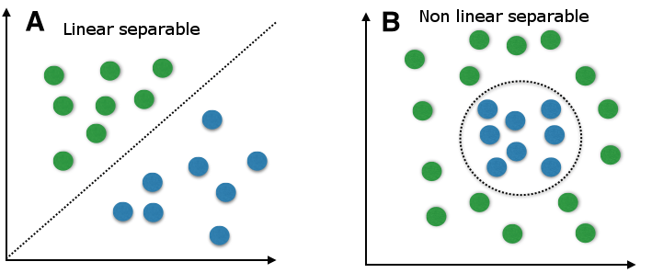
Why go deep?
Single layer perceptrons can only handle linear separability
Depth = complexity
Notes:
A major reason is that how the data is represented is important. On the left, if you were tasked with using a straight line to separate the two types of data, you would fail. On the right though, by simply transforming the data into a different coordinate system, it becomes very easy to do.

Slide 30
Train a simple classifier
Follow steps in this blog https://towardsdatascience.com/how-to-code-a-simple-neural-network-in-pytorch-for-absolute-beginners-8f5209c50fdd
Run the classifying cell types notebook

Slide 31
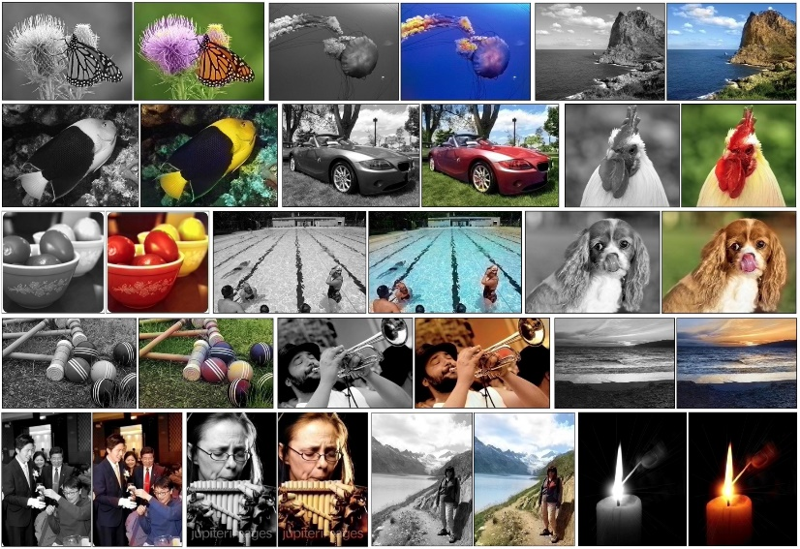
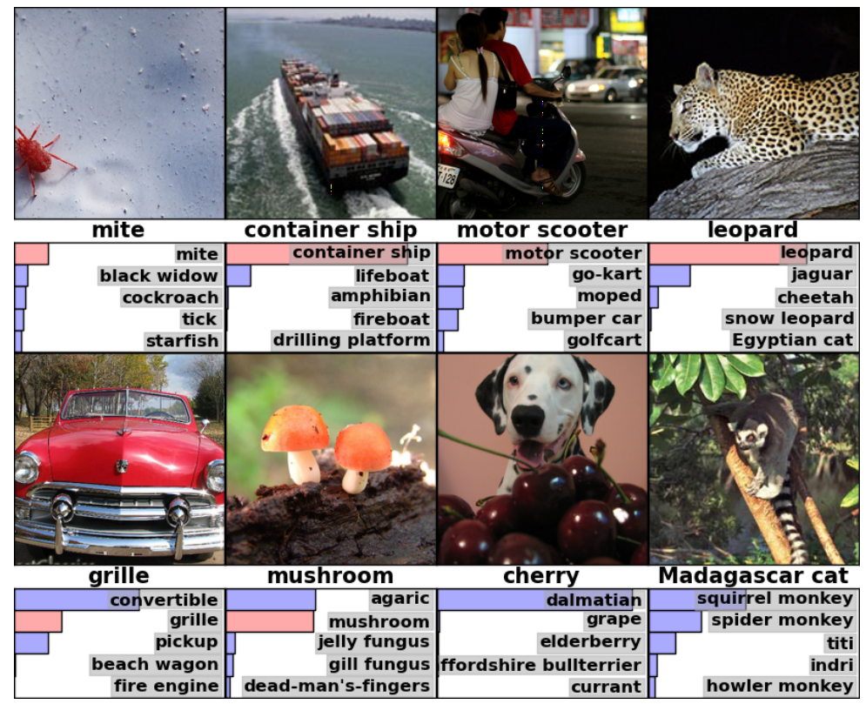

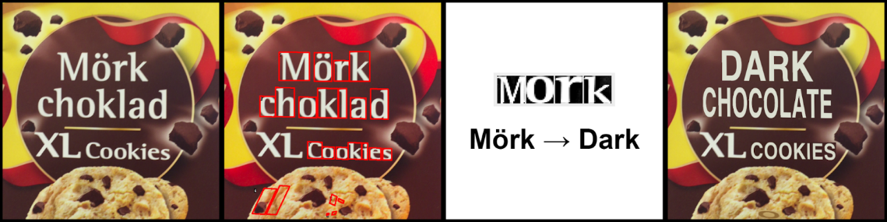
Convolutional Neural Networks
Very successful in images
Notes:
Emphasize that CNNs were used for object detection in bottom left

Slide 32
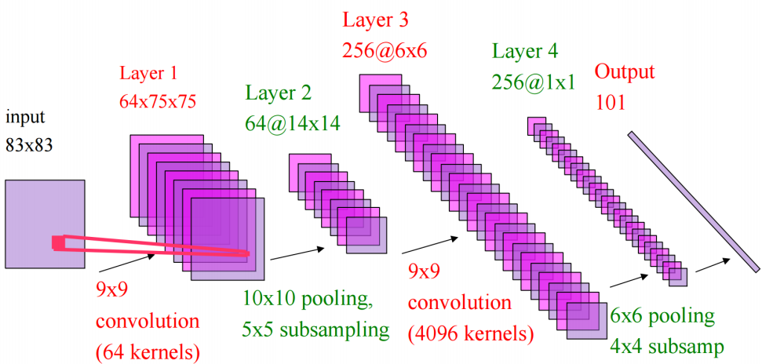
Convolutional Neural Networks
Only pixels that are close to each other in the image interact with each other (convolution layer)
Weight matrices are highly structured
“Pooling” helps to simplify output of convolution layer
Yann LeCun

Slide 33
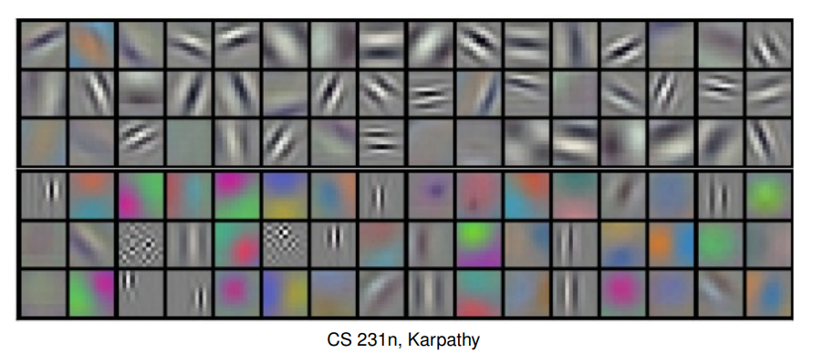
Convolutional Neural Networks
Weights from the first layer tend to look like directional filters after training
Detects edges, color change, etc.

Slide 34
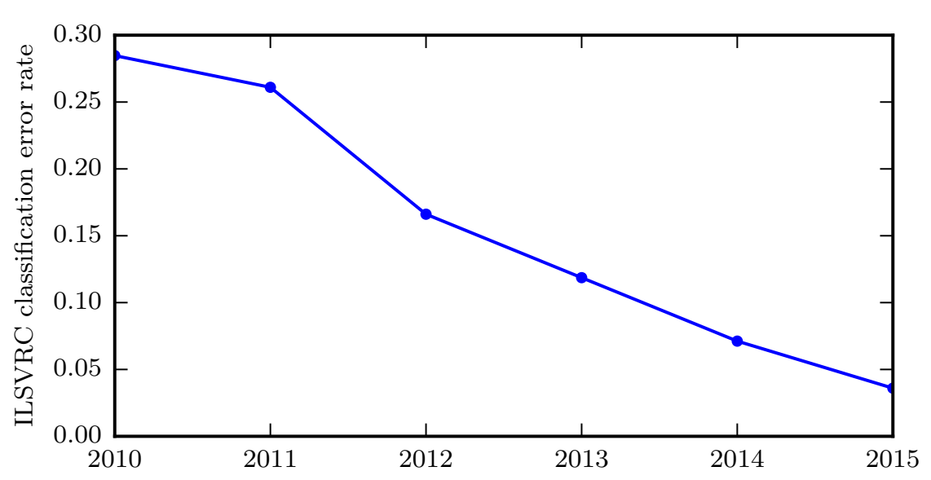
Convolutional Neural Networks (CNNs)
Goodfellow et al., 2016
Notes:
Deep neural networks have led to great success in image classification every year, largely due variations on CNNs

Slide 35
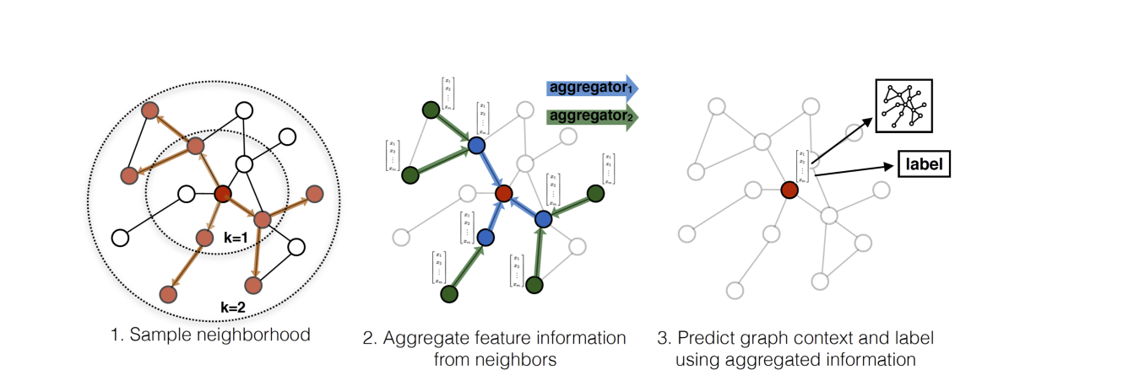
Graph Neural Networks
[Hamilton et. Al]

Slide 36
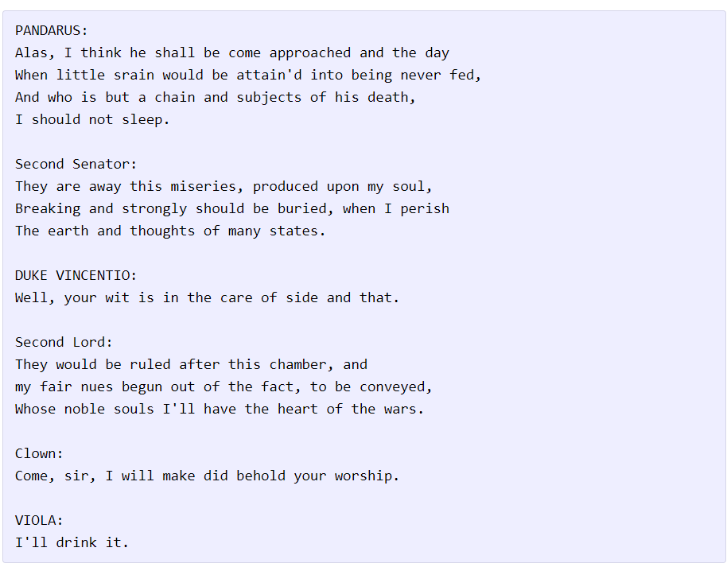
Recurrent Neural Networks (RNNs)
Useful when time is important

Slide 37
Recurrent Neural Networks (RNNs)
In feedforward nets (everything we’ve considered so far), activations of later layers are completely determined by the input
RNNs allow the hidden layers to be affected by activations at earlier times (i.e. feedback)
E.g. a neuron’s activation may include as input its activation at an earlier time
Cycles are now included in the network
This time-varying behavior make RNNs useful for analyzing data that change over time (e.g. speech)
Training can be difficult for long-term dependencies

Slide 38
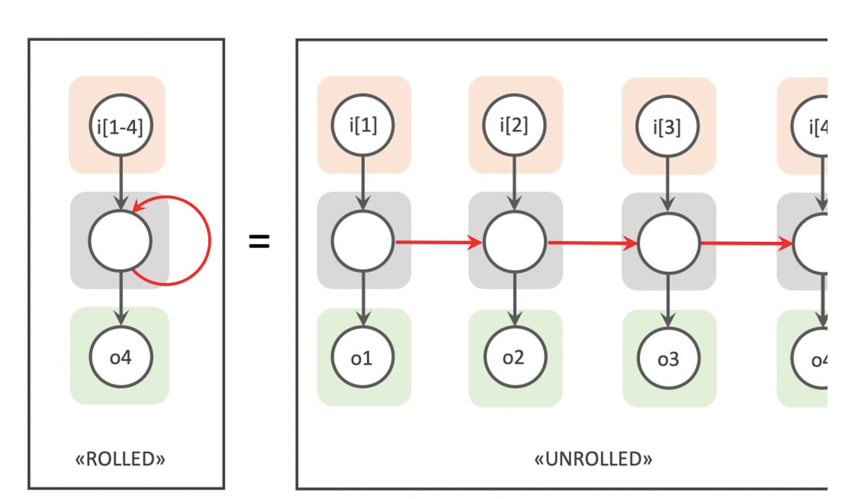
Recurrent Neural Network
By Chrislb - created by Chrislb, CC BY-SA 3.0, https://commons.wikimedia.org/w/index.php?curid=224513

Slide 39

Autoencoders
Attempts to compress the data and then reconstruct the input
“Bottleneck” layer
Reconstruction
By Chervinskii - Own work, CC BY-SA 4.0, https://commons.wikimedia.org/w/index.php?curid=45555552
Notes:
Somewhat similar idea to PCA

